Slide 1

ALCOHOLICS ANONYMOUS
Let’s Be
Friendly with Our Friends
Area 46 (NM) - District 7 (Roswell)
Notes:
SAMPLE C.P.C. PRESENTATION
[These slides and notes pages are offered as an example of a presentation that could be given to professionals about what A.A. is and what it is not. Please feel free to edit and change as your local needs warrant, including changing slide format as well as inserting your own graphics.]
NOTE: An electronic version of this PowerPoint presentation can be obtained by emailing your request to cpc@aa.org.
START OF NOTES SECTION
Alcoholics Anonymous is an international Fellowship of men and women who have found a solution to their drinking problem. A.A. is non-professional, self-supporting, multi-racial, apolitical and available almost everywhere. There are no age or education requirements. Membership is open to anyone who wants to do something about their drinking problem.

Slide 2
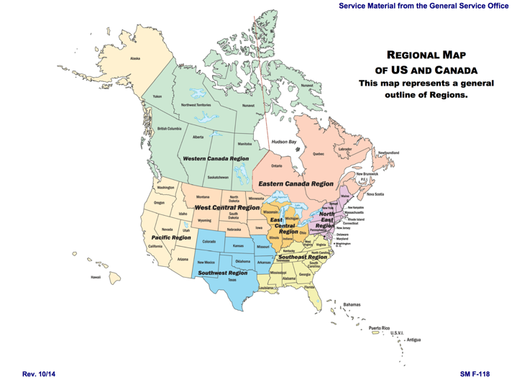
Alcoholics Anonymous in U.S. and Canada
ALCOHOLICS ANONYMOUS
WORLD SERVICES, INC.
475 Riverside Drive - 11th Floor
New York, NY 10115
[Local contact info here]
www.aa.org
www.aagrapevine.org
Notes:
ALCOHOLICS ANONYMOUS
[Local contact information]
END OF NOTES SECTION
[Feel free to use this slide to include as much local contact information as you would like. It is not necessary to keep the G.S.O. and Grapevine website links on this page. ]
NOTE: To receive this presentation electronically, please email your request to cpc@aa.org.
Rev. 3/16 F-175

Slide 3
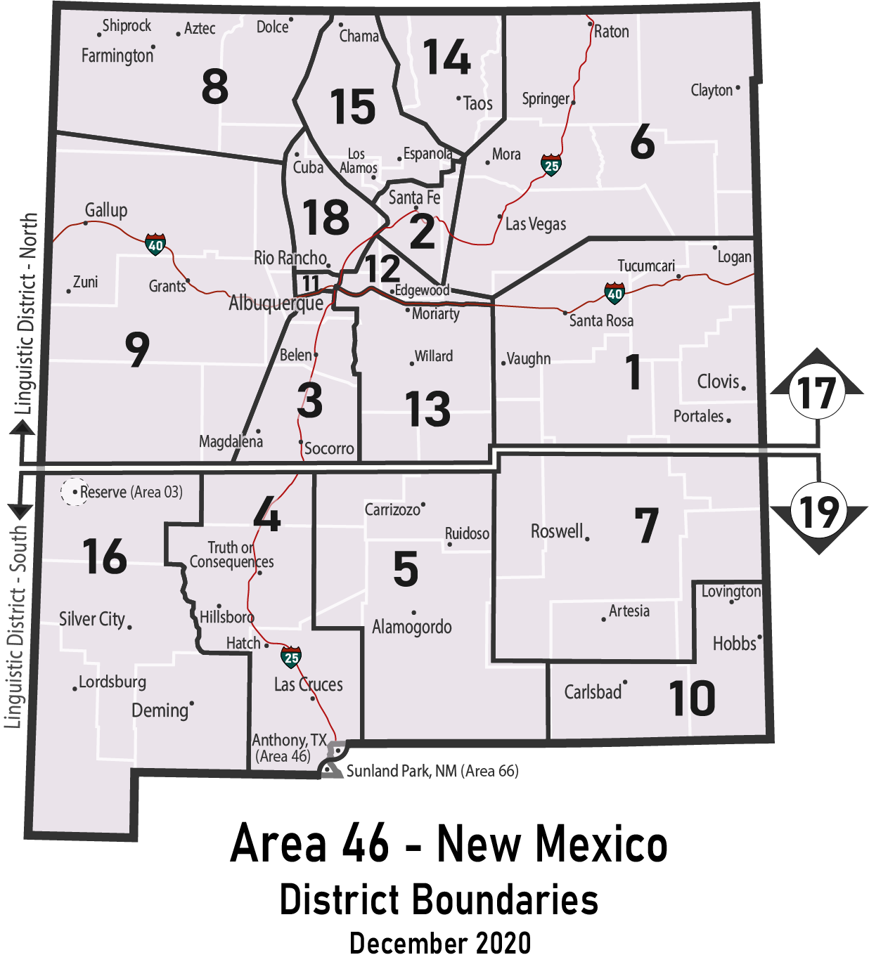
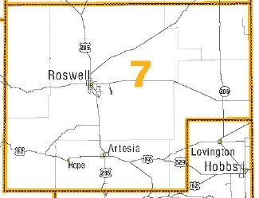

A.A. in Your Community
[Area 46 (NM)]
[District 7]
[nm-aa.org]
[district7@nm-aa.org]
ALCOHOLICS ANONYMOUS
WORLD SERVICES, INC.
475 Riverside Drive - 11th Floor
New York, NY 10115
www.aa.org
www.aagrapevine.org
Notes:
ALCOHOLICS ANONYMOUS
[Local contact information]
END OF NOTES SECTION
[Feel free to use this slide to include as much local contact information as you would like. It is not necessary to keep the G.S.O. and Grapevine website links on this page. ]
NOTE: To receive this presentation electronically, please email your request to cpc@aa.org.
Rev. 3/16 F-175

Slide 4



Some Facts About A.A.
began in 1935 – with one alcoholic, Bill W., talking to another alcoholic, Dr. Bob S. The spirit at that meeting is the same spirit that still holds A.A. meetings together in approximately 180 countries.
Notes:
SOME FACTS ABOUT A.A.
A.A. began in 1935 – with one alcoholic, Bill W., talking to another alcoholic, Dr. Bob S. The spirit at that meeting is the same spirit that still holds A.A. meetings together in approximately 180 countries.
While A.A. keeps no membership records, as of January 1, 2016 there were more than 67,000 groups and an estimated 1.38 million members in the U.S. and Canada. There are more than 117,000 groups worldwide, with approximately two million members in total.

Slide 5

The A.A. Program of Action
A way to stop drinking and stay stopped
A.A.’s suggested Twelve Steps
are the program of recovery
The Steps are based on the experience of early A.A. members
Notes:
THE A.A. PROGRAM OF ACTION
The Twelve Steps are the basis of the program of recovery and contain suggested principles that outline the actions of our early members’ experience with overcoming their alcoholism. Once someone has the desire to stop drinking, he or she attends meetings and practices the Twelve Steps to stay stopped. A.A. is not allied with any sect, denomination, politics, organization or institution. A.A. groups affiliate with no one and cooperate with all.
There are no new ideas, but rather a collection of broad spiritual principles and actions, including admission of the alcohol problem, acceptance of help from others, self-inventory, restitution for harms done, and service to others, especially to other alcoholics.
A.A. is not affiliated with any specific religion, but cooperates with the clergy of all faiths. A.A. has members who are atheist, agnostic, Christian, Buddhist, Muslim, Jewish, etc.

Slide 6

A.A.’s Spirit of Service
members help other alcoholics in
order to help themselves.
Notes:
A.A.’S SPIRIT OF SERVICE
A.A. members help other alcoholics in order to help themselves. From Page 89 of the Big Book, the basic text of Alcoholics Anonymous: “Practical experience shows that nothing will so much insure immunity from drinking as intensive work with other alcoholics. It works when other activities fail…”

Slide 7

A.A.’s Twelve Traditions
is a fellowship of men and women who share their experience, strength and hope with each other that they may solve their common problem and help others to recover from alcoholism.
Notes:
A.A.’S TRADITIONS CAN BE SUMMARIZED AS FOLLOWS
The importance of group unity.
Focusing only on helping alcoholics.
“A desire to stop drinking” is the only membership requirement.
Self-support by voluntary contributions from A.A. members only, declining monetary contributions from non-A.A. sources.
No affiliation or endorsement of other causes, including religion, alcohol education, reform or prevention.
Non-professional.
Group and member autonomy.
Personal anonymity as A.A. members at the public level including social media.
Principles before personalities.
Alcoholics Anonymous has no opinion on outside issues, hence the A.A. name ought not to be drawn into public controversy.

Slide 8

A.A. Unity
A.A.’s Twelve Traditions ensure unity and act as a guide for members, groups, and the Fellowship as a whole.
Notes:
A.A. UNITY
A.A. is not a professional organization – it is a Fellowship of men and women who share their experience, strength and hope with each other.
A.A. members are all equals with leaders who have no authority, just a sense of service and responsibility.
A.A.’s Twelve Traditions are a set of principles that ensure A.A.’s future by promoting A.A. unity and providing guidance for members and groups in their relations with each other and with the world at large.

Slide 9
What Does A.A. Do?
A.A. offers a Twelve Step program of recovery
Groups put on A.A. meetings
A.A. members share their experience
Local committees carry the A.A. message
Notes:
WHAT DOES A.A. DO?
The A.A. program of recovery, set forth in our Twelve Steps, offers the alcoholic a way to stop drinking alcohol, and stay stopped; and become a useful and productive member of society.
This recovery program is discussed at A.A. group meetings.
A.A. members share their experience with anyone seeking help with a drinking problem.
A.A. members give person-to-person attention to the alcoholic coming to A.A. This is ongoing, informal and unpaid.
Local A.A. committees bring the A.A. message to alcoholics, upon request, as well as to professionals who encounter alcoholics in the course of their work.

Slide 10

What Does A.A. Not Do?
Solicit members
Make medical diagnoses
Provide hospitalization or drugs
Keep attendance records/case histories
Offer religious services
Address prevention, treatment, advocacy or legislation
Notes:
WHAT DOES A.A. NOT DO?
Solicit members.
Make medical or psychological diagnoses or prognoses.
Provide detox or nursing services, hospitalization, drugs, or any medical or psychiatric treatment.
Keep attendance records or case histories.
Offer religious services.
Provide housing, food, clothing, jobs, money, or any other welfare or social services.
Provide counseling.
Provide letters of reference.
Discuss prevention, treatment, advocacy, legislation, etc.

Slide 11
Singleness of Purpose
A.A.’s focus is on recovery from alcoholism
Anyone may observe open meetings
Closed meetings are for those with a drinking problem
Anyone with a desire to stop drinking may become an A.A. member
A.A. members bring meetings into correctional and treatment facilities
Notes:
SINGLENESS OF PURPOSE
A.A. offers help to alcoholics, and the focus of A.A. meetings is recovery from alcoholism.
Anyone may observe A.A. meetings designated as open to see how A.A. works.
Only those with a drinking problem may attend closed meetings or become A.A. members.
Anyone who suffers from problems other than alcoholism can become an A.A. member if they also have a drinking problem.
The A.A. Fellowship makes its message freely available. What the alcoholic does with it is up to him or her.
A.A. meetings are often brought into correctional and treatment facilities, upon request.

Slide 12
Proof of Attendance at A.A. Meetings
Sometimes a referral source asks for proof of attendance at A.A. meetings.
Groups cooperate in different ways. There is no set procedure. The nature and extent of any group’s involvement in this process is entirely up to the individual group.
Some groups with the consent of the prospective member, have an A.A. member acknowledge attendance on a slip that has been furnished by the referral source. The referred person is responsible for returning the proof of attendance.
Notes:
WHAT ABOUT PROOF OF ATTENDANCE AT A.A. MEETINGS?
Some professionals give the person referred to A.A. a slip to have signed at the meeting, to verify the person’s attendance there. All involved recognize that neither the group nor the members are ‘bound’ by the signature.
Signing an attendance slip does not signify that the group is affiliated with, or endorses, any outside entity.
A.A. members are not required to verify attendance or sign slips. Members and groups independently choose whether or not participate in this practice.

Slide 13

A.A. and Professionals
Notes:
A.A. MEMBERS AND PROFESSIONALS INTERACT
A referral from a professional may provide the motivation an individual needs to seek help.
A.A. members provide a support network, meetings and practical experience for those who want to stop drinking and stay sober.
A.A. members are available in your community to offer help to your alcoholic clients or patients.
Informational meetings or presentations can also be arranged for professionals who have an interest in learning more about what A.A. is and what it is not.

Slide 14

Information for Professionals
Notes:
INFORMATION FOR PROFESSIONALS
Professionals who work with alcoholics share a common purpose with Alcoholics Anonymous: to help the alcoholic stop drinking and lead a healthy, productive life.
We can serve as a source of personal experience with alcoholism and as an ongoing support system for recovering alcoholics.
Alcoholics Anonymous has many A.A. members and service committees who are available to provide professionals with information about Alcoholics Anonymous.
A.A. has a long history of cooperating but not affiliating with outside organizations and being available to provide A.A. meetings or presentations about A.A. upon request.
A.A. communicates with professionals such as doctors or other healthcare professionals, members of the clergy, law enforcement or court officials, educators, social workers, alcoholism counselors, therapists, or others who deal with problem drinkers in the course of their work.

Slide 15


GRAPEVINE/LA VIÑA
475 Riverside Drive, 11th Floor
New York, NY 10115
www.aagrapevine.org
Notes:
GRAPEVINE/LA VIÑA
A.A. Grapevine magazine, an international journal of Alcoholics Anonymous commonly called “our meeting in print,” and its sister magazine in Spanish, La Viña, are also produced in New York. These magazines can be useful resources for you as professionals.

Slide 16
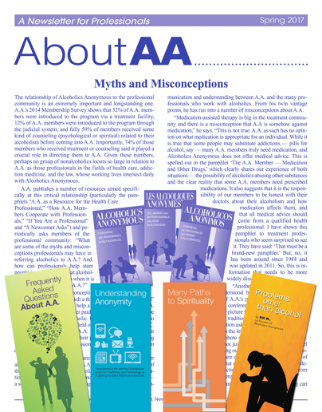
How Can You Cooperate with A.A. to Help your Patients/Clients?
Maintain contact with the local A.A. community
Observe open A.A. meetings
Read A.A. literature and view pages/videos on www.aa.org directed to professionals
Subscribe to About A.A. newsletter (free) / Grapevine or La Viña magazines (cost)
Contact the General Service Office to get connected with local A.A.s
Notes:
HOW CAN YOU COOPERATE WITH A.A. TO HELP YOUR PATIENTS/CLIENTS?
Maintain contact with the local A.A. community.
Contact a local central office or intergroup for open A.A. meeting information.
Observe open A.A. meetings yourself.
Talk to people in A.A. about their A.A. experiences and learn from them about recovery.
Read A.A. literature – the Big Book, Twelve Steps and Twelve Traditions, and numerous pamphlets.
Subscribe to About A.A. newsletter for professionals (no charge) and to AA Grapevine or the Spanish language La Viña magazines (subscription fee).
Contact the General Service Office in New York to get connected with A.A. in your community.

